Slide 1
Effect Size

Slide 2

What is Effect Size?
A measure of significance that DOES NOT rely on sample size
p value is calculated using sample size
The more data you have, the more likely it will be significant
Ex. Aspirin

Slide 3
Effect Size for Different Statistics
Statistic | Effect Size
t-test | Cohen’s D
Chi-Square | Cramer’s V
Regression | R Squared
ANOVA | Eta-Squared

Slide 4
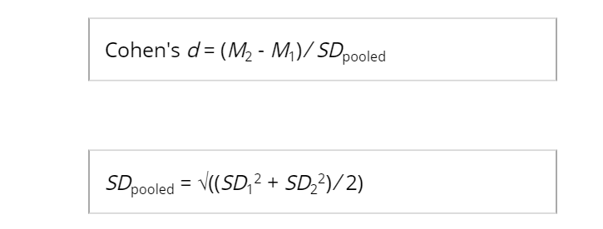
How to Calculate Cohen’s D for Independent
No sample size in there!!
https://www.socscistatistics.com/effectsize/default3.aspx#:~:text=For%20the%20independent%20samples%20T,by%20the%20pooled%20standard%20deviation.&text=Cohen's%20d%20is%20the%20appropriate,are%20of%20the%20same%20size.

Slide 5
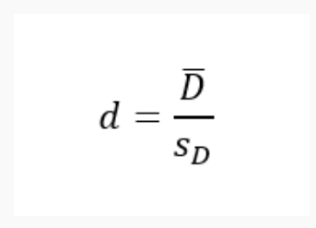
How to Calculate Cohen’s D for Dependent
Mean / standard deviation for the DIFFERENCE
No sample size in there!!

Slide 6
Interpreting Cohen’s D
Small: <= 0.2
Medium: 0.3 - 0.5
Large: > 0.6

